Slide 1

Student Athlete App
Ben Eiffert, Emersyn Funk, Brianna Rawlings

Slide 2
Introduction

Slide 3
Problem Statement
Student athletes can only compete well if they fuel their bodies well. However, proper nutrition requires multiple resources: knowledge, good dining options, time, money, proximity to grocery stores, and proper cookware.
It is difficult for student athletes to spend time planning what to eat, how much of it, and when to eat it with actual diets because of schedules, workouts, and lack of availability of good resources on college campuses. These obstacles lead to under-fueled athletes who struggle to recover from workouts and are not able to perform to the best of their ability.

Slide 4
Solution
We propose an all-in-one resource where customized recipes and shopping lists are provided for athletes based on workout and competition schedules.
Assumptions: We assume that athletes will know their training plan ahead of time and that they have the resources to actually make the meals suggested for them. We also will assume that we have proper nutrition knowledge to create these meal plans.
HCI Features: We will focus on eliminating the planning and research required to create a science-based nutrition plan, and look at specifically how the user will input their training schedule, how they will select what meals and ingredients fit their dietary preferences, and how much nutrition information the application will provide.

Slide 5
Why This Matters to Us and You
Users
Right now Student Athletes
Taylor, College Students, Athletes in general
Student Athletes Ourselves
Fueling our bodies properly/Nutrition
Help solve the problem of food options for athletes right now, but even for those who aren't technically "athletes"

Slide 6
Design Story

Slide 7
User Interviews
Things We Learned
Athletes want to be able to pick their own meals
General macros recommended should be provided as well
Meals need to be customizable
Things We Confirmed
Athletes of all sports see a direct correlation between food and performance
Many athletes feel under-qualified to plan their own meals

Slide 8
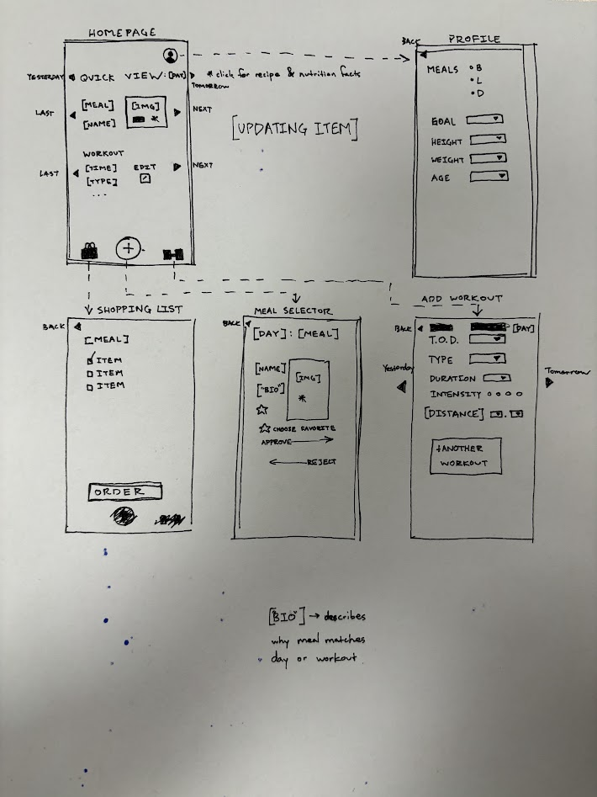
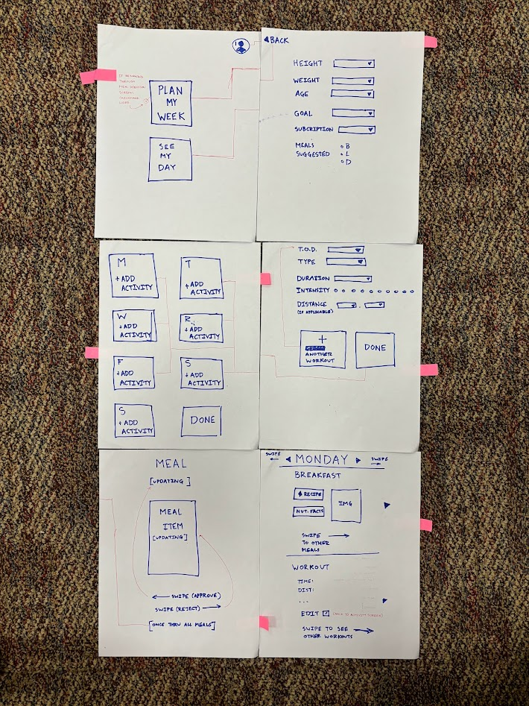
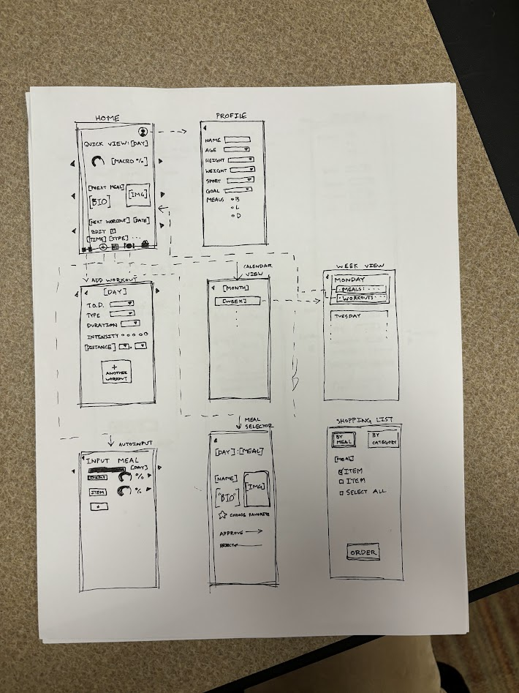
Milestone 1
Homepage, activity add, day view, profile. We like swiping! | Added a shopping list & favoriting. Each page is accessible within 1 click. | We added a calendar! Along with this, we added macro-nutrient visualizations.
Notes:
These initial designs were part of the divergence phase in design. We tried a lot of different things, with different levels of success. I want to walk you through a few of the ideas we had, both good and bad.
Looking at this first page, you’ll see a basic layout that we somewhat kept throughout the whole project. We had a homepage, activity add, day view, and profile, along with swiping functionality. However, this prototype was lacking some functionality that we needed, so we added favoriting and a shopping list, then a calendar view in the third wireframe. We also added visualizations of macro-nutrient goals throughout the day.

Slide 9
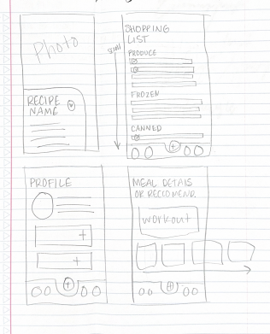
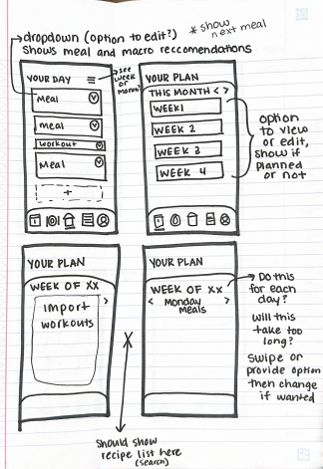
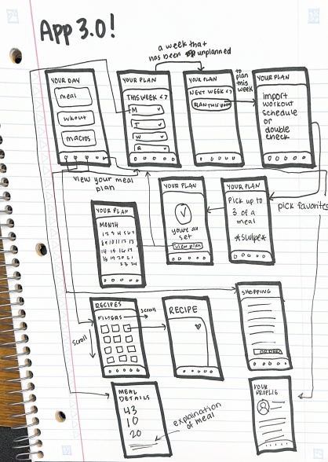
Milestone 1, cont.
We liked the navigation at the bottom and favoriting functionality. | In this iteration, we further developed user flow, along with creation of plans. We loved the week view. | This iteration further connected actions with screens.
Notes:
Looking then to more examples from Milestone 1, we each approached this app from different perspectives. This prototype used a navigation bar and favoriting from the beginning, then developed further flow. One of the primary items we pulled out of this second prototype was the “week view,” which allows you to view all recipes and meals within a specific week, along with planning the next week.

Slide 10
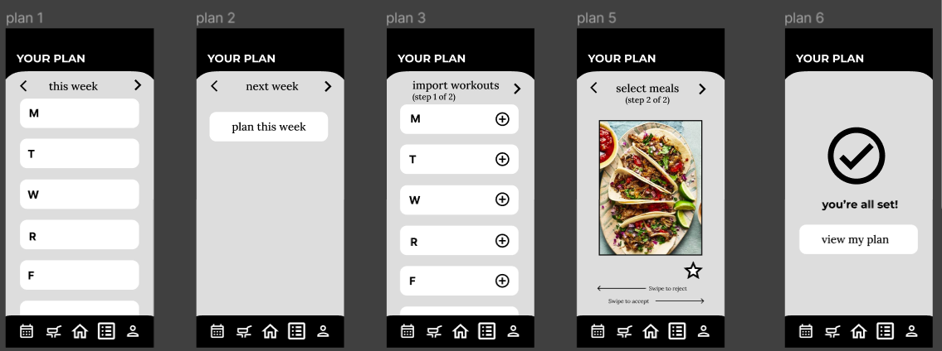
Milestone 2
Convergence from paper to Figma
Successes: week view, meal planning, home page, and profile
Issues: "favoriting" meals, unclickable items, buried functionality
Ideas: add "back arrows," place more items on the home screen, and signifiers when meal-planning
Notes:
For our second milestone, we moved from Paper to Figma. In this milestone, we converged on a single prototype. We set up different pages for different functions. We had “week views” set up, meal planning, a home page, and profile view.
However, this prototype was far from perfect. “Favoriting” a meal was incredibly difficult for people. Further, some of our items and icons were unclickable. Signifiers did not always match affordances. We also wanted to clean up our meal planning because it was completely buried in our calendar. We also needed to add “back arrows” and additional signifiers when meal-planning, along with placing more items directly on the home screen.

Slide 11
Milestone 3
Improving User Interface
Error Handling
Improved user flow and limiting confusion

Slide 12
Final Prototype

Slide 13
Walkthrough
https://www.figma.com/file/vhOmKdoaZ35nu9lt8o5w0X/HCI-project?type=design&node-id=0%3A1&mode=design&t=BBGfE4nFVmqiYyFA-1

